Slide 1




The course notes are partly based on the Machine learning course presented by Andrew Ng at Stanford University and the original can be found at https://www.coursera.org/course/ml b
e.
All materials without annotations or marks are copyrighted by their copyright owner.
All the codes and modified slides are available at Github & OSChina
The project homepage:
https://github.com/sunzuolei/ml
https://git.oschina.net/samuel/ml
The Git repository:
https://github.com/sunzuolei/ml.git
https://git.oschina.net/samuel/ml.git

Slide 2
The issues you may face when designing a complex machine learning system

Slide 3



Slide 4

Prioritizing what to work on: Spam classification example
Machine learning system design
Machine Learning

Slide 5

Building a spam classifier
SPAM
NON-SPAM
From: cheapsales@buystufffromme.com
To: ang@cs.stanford.edu
Subject: Buy now!
Deal of the week! Buy now!
Rolex w4tchs - $100
Med1cine (any kind) - $50
Also low cost M0rgages available.
From: Alfred Ng
To: ang@cs.stanford.edu
Subject: Christmas dates?
Hey Andrew,
Was talking to Mom about plans for Xmas. When do you get off work. Meet Dec 22?
Alf

Slide 6
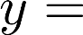
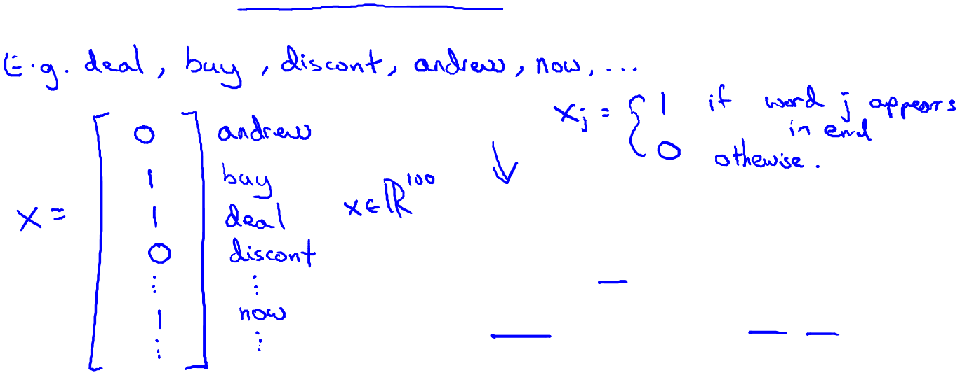
Building a spam classifier
Supervised learning. features of email. spam (1) or not spam (0).
Features : Choose 100 words indicative of spam/not spam.
deal
buy
discount
Andrew
now
…
From: cheapsales@buystufffromme.com
To: ang@cs.stanford.edu
Subject: Buy now!
Deal of the week! Buy now!
NOTE: In practice, take most frequently occurring n words ( 10,000 to 50,000) in training set, rather than manually pick 100 words.

Slide 7
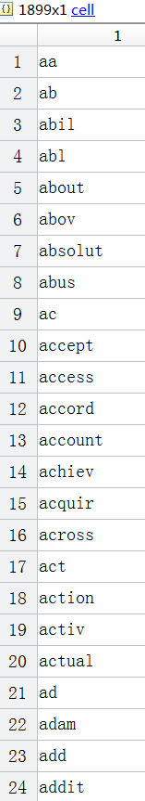
vocabList
spamTrain.mat
file_contents = readFile(filename);
word_indices = processEmail(file_contents);
x = emailFeatures(word_indices);

Slide 8

Building a spam classifier
How to spend your time to make it have low error?
Collect lots of data
E.g. “honeypot” project.
GETTING LOTS OF DATA WILL OFTEN HELP, BUT NOT ALL THE TIME.

Slide 9
Building a spam classifier
How to spend your time to make it have low error?
Collect lots of data
E.g. “honeypot” project.
Develop sophisticated features based on email routing information (from email header).
Spammers often try to obscure the origins of the email, and maybe use fake email headers. Or send email through very unusual sets of computer service. Through very unusual routes, in order to get the spam to you. And some of this information will be reflected in the email header. So looking at the email headers and develop more sophisticated features to capture this sort of email routing information to identify SPAM.

Slide 10
Building a spam classifier
How to spend your time to make it have low error?
Collect lots of data
E.g. “honeypot” project.
Develop sophisticated features based on email routing information (from email header).
Develop sophisticated features for message body, e.g. should “discount” and “discounts” be treated as the same word? How about “deal” and “Dealer”? Features about punctuation?

Slide 11
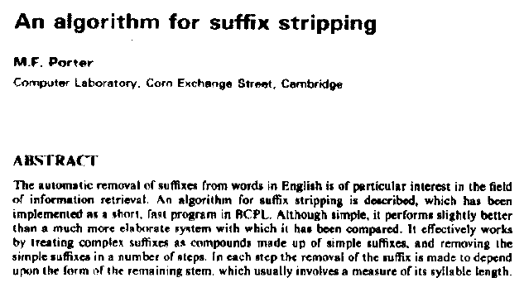
http://tartarus.org/martin/PorterStemmer/
M.F. Porter, 1980, An algorithm for suffix stripping, Program, 14(3) pp 130−137.
function stem = porterStemmer(inString)

Slide 12
Building a spam classifier
How to spend your time to make it have low error?
Collect lots of data
E.g. “honeypot” project.
Develop sophisticated features based on email routing information (from email header).
Develop sophisticated features for message body, e.g. should “discount” and “discounts” be treated as the same word? How about “deal” and “Dealer”? Features about punctuation?
Develop sophisticated algorithm to detect misspellings (e.g. m0rtgage, med1cine, w4tches.)

Slide 13
Error analysis
Machine learning system design
Machine Learning

Slide 14
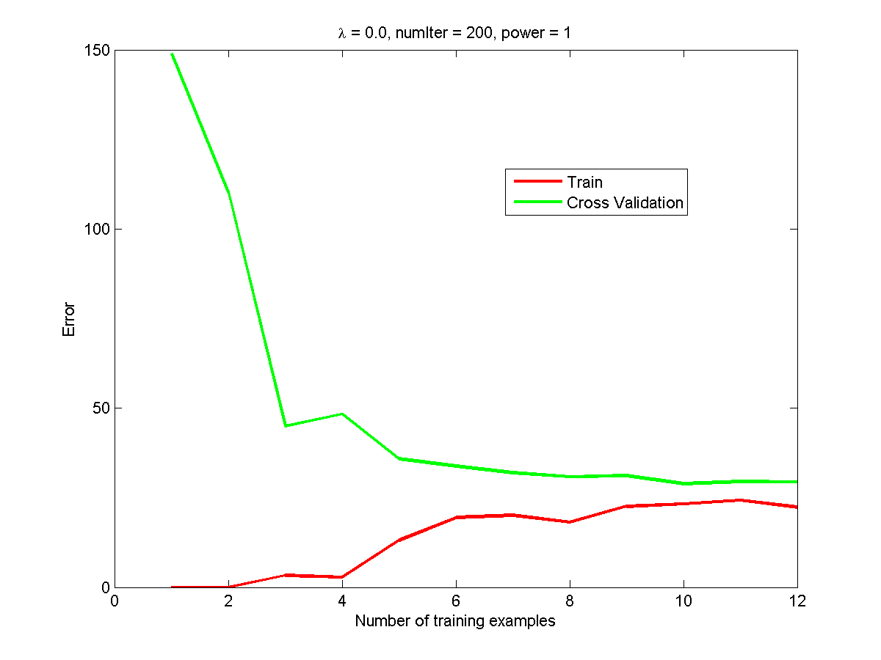
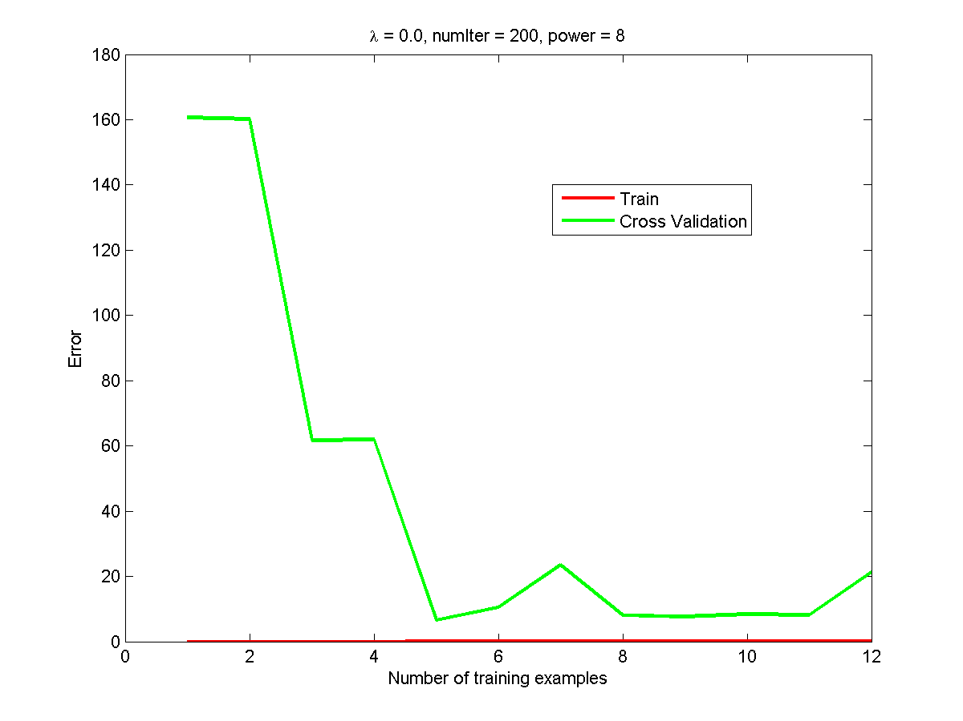
Recommended approach
Start with a simple algorithm that you can implement quickly. Implement it and test it on your cross-validation data.
Plot learning curves to decide if more data, more features, etc. are likely to help.
Underfit
High bias
Overfit
High variance

Slide 15
Recommended approach
Start with a simple algorithm that you can implement quickly. Implement it and test it on your cross-validation data.
Plot learning curves to decide if more data, more features, etc. are likely to help.
Error analysis: Manually examine the examples (in cross validation set) that your algorithm made errors on. See if you spot any systematic trend in what type of examples it is making errors on.

Slide 16
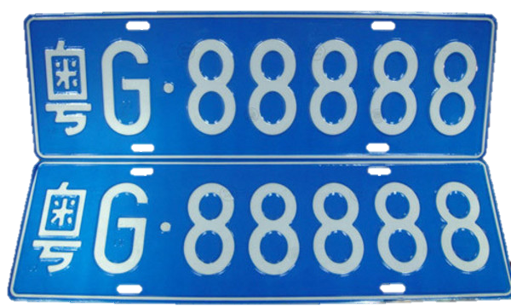

Slide 17
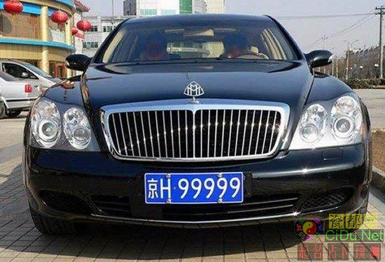
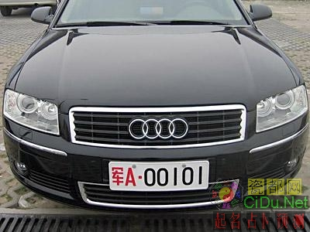
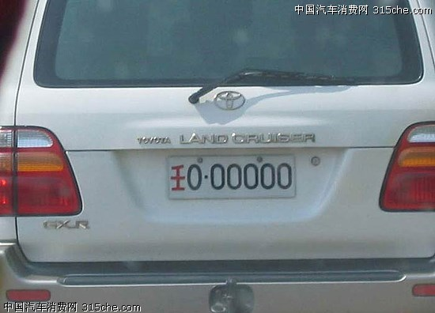
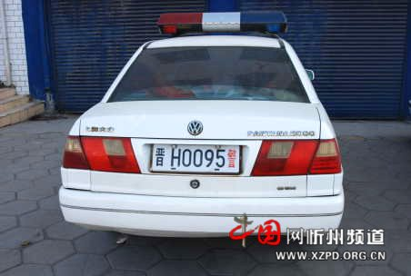
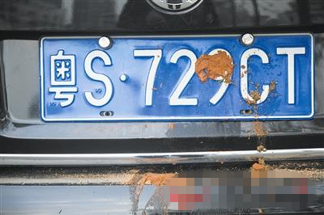
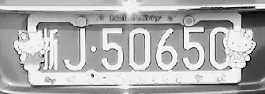
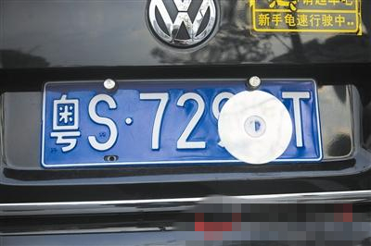
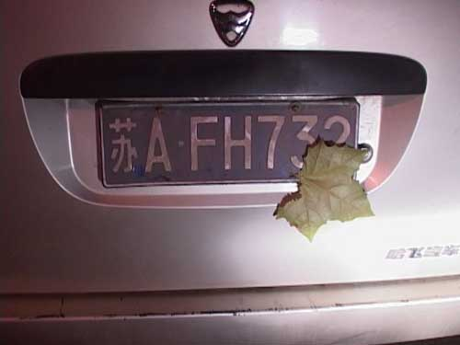
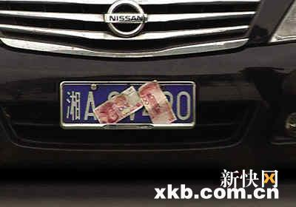

Slide 18
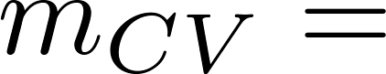
Error Analysis
500 examples in cross validation set
Algorithm misclassifies 100 emails.
Manually examine the 100 errors, and categorize them based on:
What type of email it is
What cues (features) you think would have helped the algorithm classify them correctly.
Pharma:
Replica/fake:
Steal passwords:
Other:
Deliberate misspellings:
(m0rgage, med1cine, etc.)
Unusual email routing:
Unusual (spamming) punctuation:

Slide 19
The importance of numerical evaluation
Should discount/discounts/discounted/discounting be treated as the same word?
Can use “stemming” software (E.g. “Porter stemmer”)
universe/university.
“Overview of Stemming Algorithms” Ilia Smirnov
Dr. Martin Porter's stemmer page
http://tartarus.org/~martin/PorterStemmer/
Javascript demo
http://qaa.ath.cx/porter_js_demo.html
http://the-smirnovs.org/info/stemming.pdf

Slide 20


The importance of numerical evaluation
Should discount/discounts/discounted/discounting be treated as the same word?
Can use “stemming” software (E.g. “Porter stemmer”)
universe/university.
Error analysis may not be helpful for deciding if this is likely to improve performance. Only solution is to try it and see if it works.
Need numerical evaluation (e.g., cross validation error) of algorithm’s performance with and without stemming.
Without stemming: With stemming:
8% error
5% error
Distinguish upper vs. lower case (Mom/mom):

Slide 21
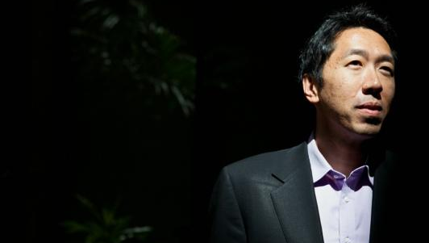
When you' re developing a learning algorithm, very often you'll be trying out lots of new ideas and algorithms. By having a single rule number evaluation metric, you can then just look and see, did the error go up or go down?

Slide 22
When starting on the new machine learning problem, what I always recommend is to implement a quick and dirty implementation. I pretty much only ever see people spend too much time building their first implementations. So don't worry about it being too quick, or don't worry about it being too dirty. But really implement something as quickly as you can.

Slide 23
Once you have the initial implementation this is then a powerful tool for deciding where to spend your time next, because first we can look at the errors it makes, and do error analysis to see what mistakes it makes and use that to inspire further development. And second, a single real number evaluation metric can then be a vehicle to try out different ideas and quickly see if they are improving the performance and therefore let you much more quickly make decisions about what things to incorporate into your algorithm.

Slide 24

Can a single number valuation metric always work?

Slide 25
Error metrics for skewed classes
Machine learning system design
Machine Learning

Slide 26
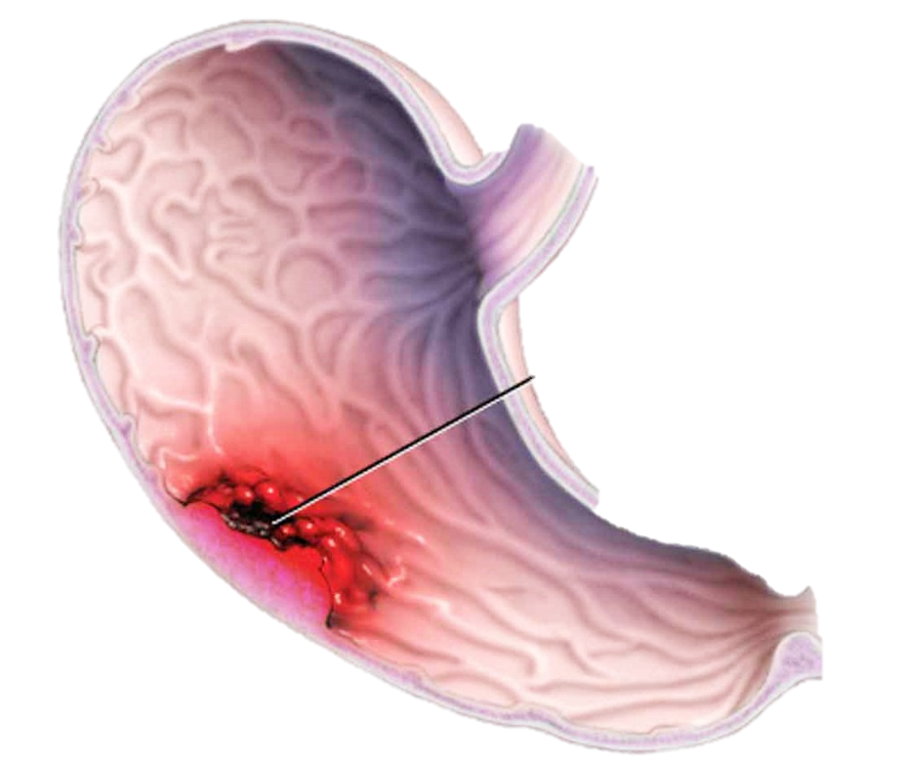
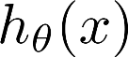
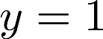
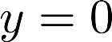
Cancer classification example
Train logistic regression model . ( if cancer, otherwise) Find that you got 1% error on test set.
(99% correct diagnoses)
Only 0.50% of patients have cancer.
function y = predictCancer(x)
y = 0; %ignore x!
return

Slide 27
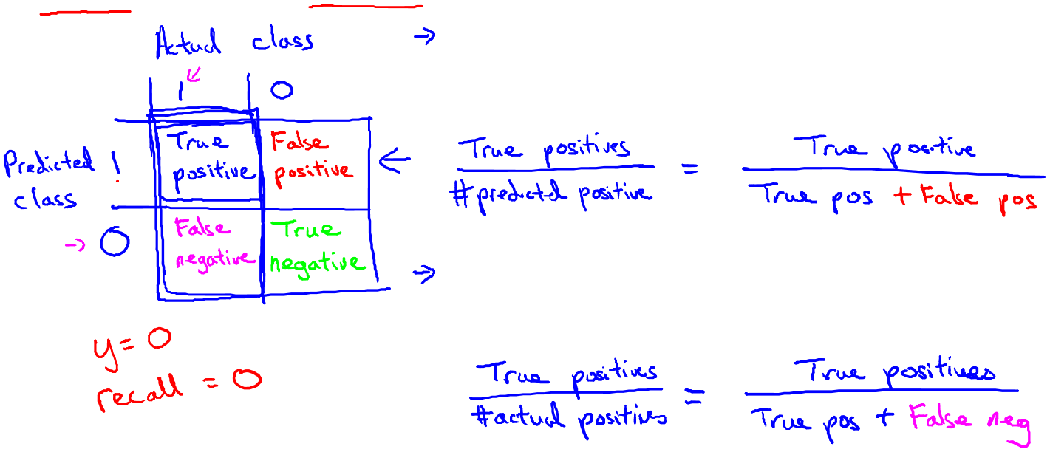
Precision/Recall
in presence of rare class that we want to detect
Precision
(Of all patients where we predicted , what fraction actually has cancer?)
Actual class
1
0
True
positive
False
positive
Predicted class
1
Recall
(Of all patients that actually have cancer, what fraction did we correctly detect as having cancer?)
False
negative
True
negative
0

Slide 28

Precision/Recall
in presence of rare class that we want to detect
Actual class
1
0
True
positive
False
positive
Predicted class
1
How does accuracy indicate?
False
negative
True
negative
0

Slide 29
Precision/Recall
in presence of rare class that we want to detect
Actual class
1
0
True pos + True neg
True
positive
False
positive
Predicted class
1
True pos + True neg
+
False
negative
True
negative
0
False pos + False neg

Slide 30
Precision/Recall
in presence of rare class that we want to detect
Actual class
1
0
True pos + True neg
True
positive
False
positive
Predicted class
1
m
False
negative
True
negative
0

Slide 31
Trading off precision and recall
Machine learning system design
Machine Learning

Slide 32
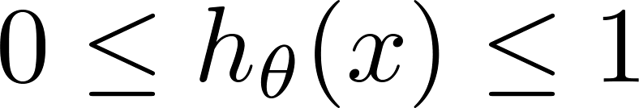
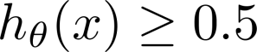
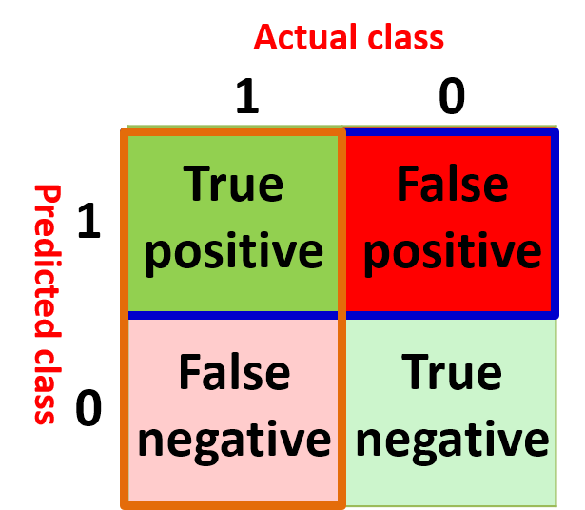
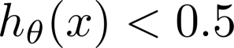
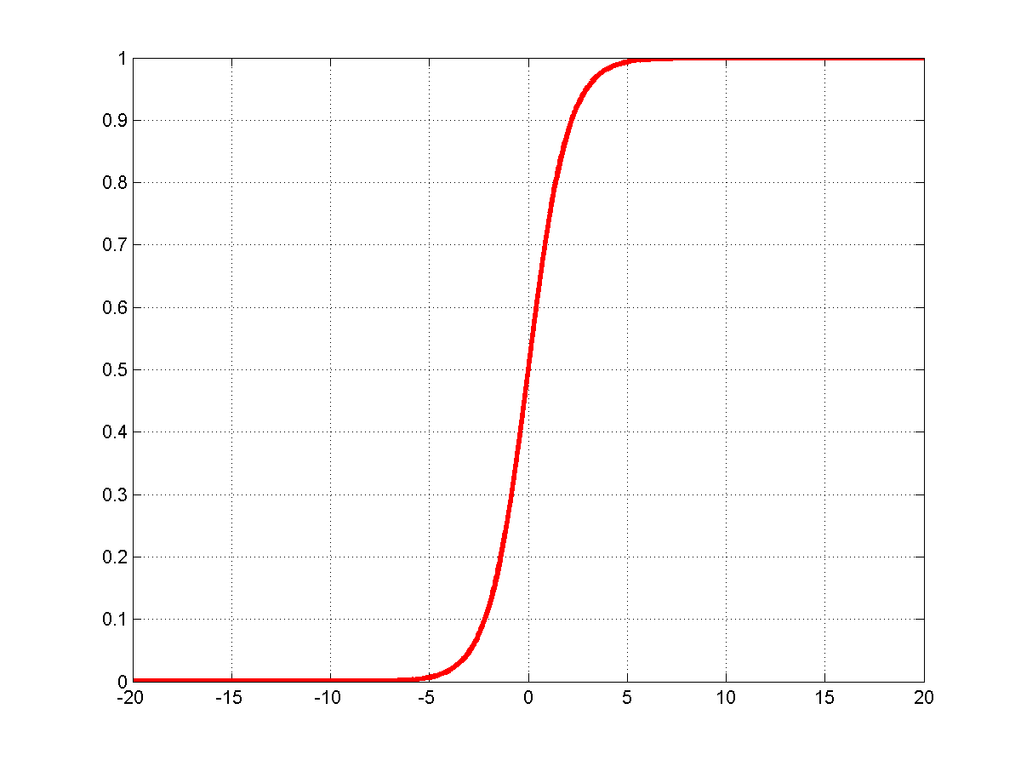
Trading off precision and recall
precision =
true positives
no. of predicted positive
Logistic regression:
Predict 1 if
Predict 0 if
recall =
true positives
no. of actual positive
Ground truth:
9
1
Cancer:
4
4
5
Non-cancer:
14
0.5
9
0
9

Slide 33
Accuracy:
4+9
true positives
= 72.2%
precision =
18
no. of predicted positive
Precision:
recall =
true positives
4
no. of actual positive
= 44.4%
9
Recall:
4
= 100%
4
Ground truth:
9
1
Cancer:
4
4
5
Non-cancer:
14
0.5
9
0
9

Slide 34
Trading off precision and recall
precision =
true positives
no. of predicted positive
Logistic regression:
Predict 1 if
Predict 0 if
recall =
true positives
no. of actual positive
0.99
0.99
Suppose we want to predict (cancer)
only if very confident.
3
Ground truth:
1
Cancer:
4
3
0
Non-cancer:
14
15
0.5
1
14

Slide 35
Accuracy:
3+14
true positives
= 94.4%
precision =
18
no. of predicted positive
Precision:
recall =
true positives
3
no. of actual positive
= 100%
3
Recall:
3
= 75%
4
3
Ground truth:
1
Cancer:
4
3
0
Non-cancer:
14
15
0.5
1
14

Slide 36
Accuracy:
1+14
true positives
= 83.3%
precision =
18
no. of predicted positive
Precision:
recall =
true positives
1
no. of actual positive
= 100%
1
Recall:
1
= 25%
4
1
Ground truth:
1
Cancer:
4
1
0
Non-cancer:
14
17
0.5
3
14

Slide 37
Logistic regression:
Predict 1 if
Predict 0 if
true positives
precision =
no. of predicted positive
0.1
recall =
true positives
0.1
no. of actual positive
Suppose we want to avoid missing too many cases of cancer (avoid false negatives).
Ground truth:
1
Cancer:
4
14
4
10
Non-cancer:
14
0.5
0
4
4

Slide 38
Accuracy:
4+4
true positives
= 44.4%
precision =
18
no. of predicted positive
Precision:
recall =
true positives
4
no. of actual positive
= 28.5%
14
Recall:
4
= 100%
4
Ground truth:
1
Cancer:
4
14
4
10
Non-cancer:
14
0.5
0
4
4

Slide 39
Accuracy:
4
true positives
= 22.2%
precision =
18
no. of predicted positive
Precision:
recall =
true positives
4
no. of actual positive
= 22.2%
18
Recall:
4
= 100%
4
Ground truth:
1
Cancer:
4
18
4
14
Non-cancer:
14
0.5
0
0
0

Slide 40

Threshold | 0 | 0.1 | 0.5 | 0.99 | 0.999
Accuracy | 0.222 | 0.444 | 0.722 | 0.94 | 0.833
Precision | 0.22 | 0.285 | 0.444 | 1 | 1
Recall | 1 | 1 | 1 | 0.75 | 0.25

Slide 41
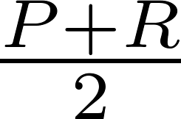
Threshold | 0 | 0.1 | 0.5 | 0.99 | 0.999
Accuracy | 0.222 | 0.444 | 0.722 | 0.94 | 0.833
Precision | 0.22 | 0.285 | 0.444 | 1 | 1
Recall | 1 | 1 | 1 | 0.75 | 0.25
Average | 0.61 | 0.642 | 0.722 | 0.875 | 0.625

Slide 42
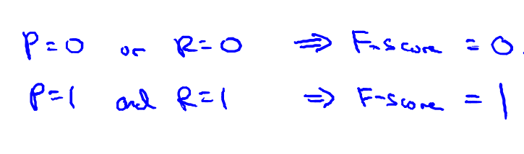
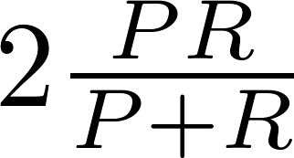
F₁ Score (F score)
How to compare precision/recall numbers?
F₁ Score:
 | Precision(P) | Recall (R) | Average | F₁ Score
Algorithm 1 | 0.5 | 0.4 | 0.45 | 0.444
Algorithm 2 | 0.7 | 0.1 | 0.4 | 0.175
Algorithm 3 | 0.02 | 1.0 | 0.51 | 0.0392

Slide 43
Threshold | 0 | 0.1 | 0.5 | 0.99 | 0.999
Accuracy | 0.222 | 0.444 | 0.722 | 0.94 | 0.833
Precision | 0.22 | 0.285 | 0.444 | 1 | 1
Recall | 1 | 1 | 1 | 0.75 | 0.25
Average | 0.61 | 0.642 | 0.722 | 0.875 | 0.625
F1 Score | 0.36 | 0.44 | 0.61 | 0.85 | 0.4

Slide 44
Data for machine learning
Machine learning system design
Machine Learning

Slide 45
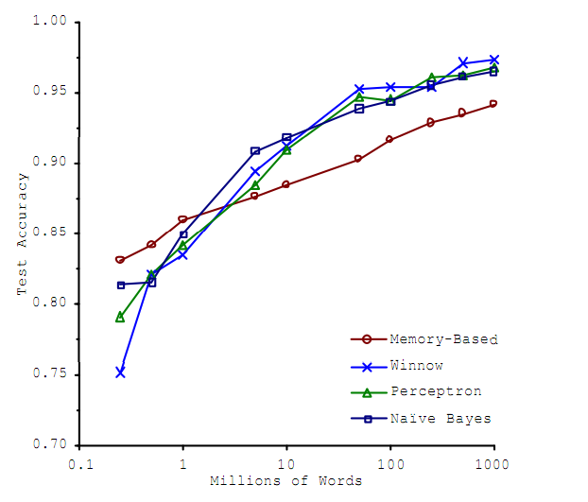
Designing a high accuracy learning system
E.g. Classify between confusable words.
{to, two, too}, {then, than}
For breakfast I ate _____ eggs.
Algorithms
Perceptron (Logistic regression)
Winnow
Memory-based
Naïve Bayes
Accuracy
Training set size (millions)
_{[Banko and Brill, 2001]}

Slide 46
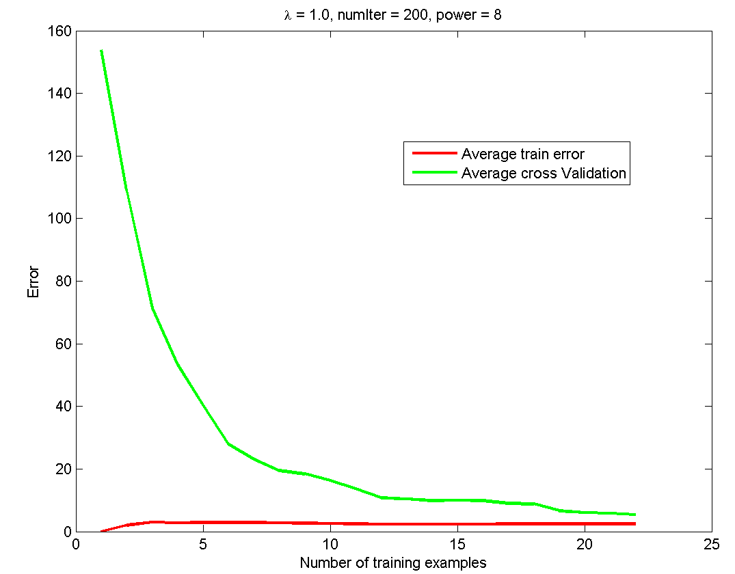

Slide 47
Designing a high accuracy learning system
E.g. Classify between confusable words.
{to, two, too}, {then, than}
For breakfast I ate _____ eggs.
Algorithms
Perceptron (Logistic regression)
Winnow
Memory-based
Naïve Bayes
Accuracy
Training set size (millions)
“It’s not who has the best algorithm that wins.
It’s who has the most data.”
_{[Banko and Brill, 2001]}

Slide 48
Both the train error and cross validation error are high when the number of training examples is increased. This reflects a high bias problem in the model, the linear regression model is too simple and is unable to fit our dataset well.
Underfit
High bias

Slide 49
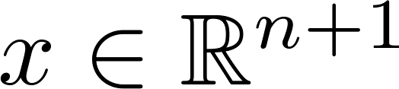


Large data rationale
Assume feature has sufficient information to predict accurately.
Example: For breakfast I ate _____ eggs.
Counterexample: Predict housing price from only size (feet²) and no other features.
Useful test: Given the input , can a human expert confidently predict ?

Slide 50
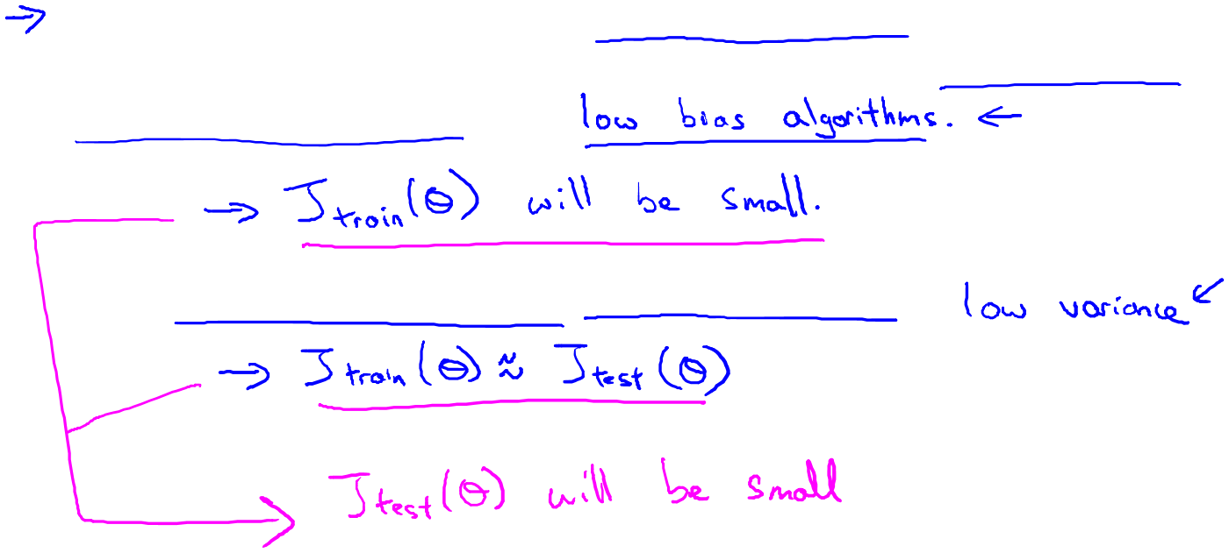
Large data rationale
Use a learning algorithm with many parameters (e.g. logistic regression/linear regression with many features; neural network with many hidden units).
Use a very large training set (unlikely to overfit)
Low bias
Low variance

